Slide 1
Dvd rental store
An Analysis

Slide 2
Introduction
The Sakila database represents a DVD rental store, and our goal was to explore and analyze this database using Power BI. This report outlines the steps taken for data exploration, understanding table relationships, and addressing specific analytical questions.

Slide 3
Data Exploration
The initial step was to explore the structure and content of the Sakila database. The primary tables of interest included:
Customer: Information about customers.Rental: Details of DVD rentals.
Inventory: Inventory details of DVDs.Film: Information about films.
Payment: Payment transactions.
Category: Categories of films.
Actor: Information about actors.

Slide 4
The schema was loaded into power bi and the relationship was noted, I went to the data model and the different relationships between tables.
There was a one to many relationship, a many to many relationship (Film category was linked to other categories)

Slide 5
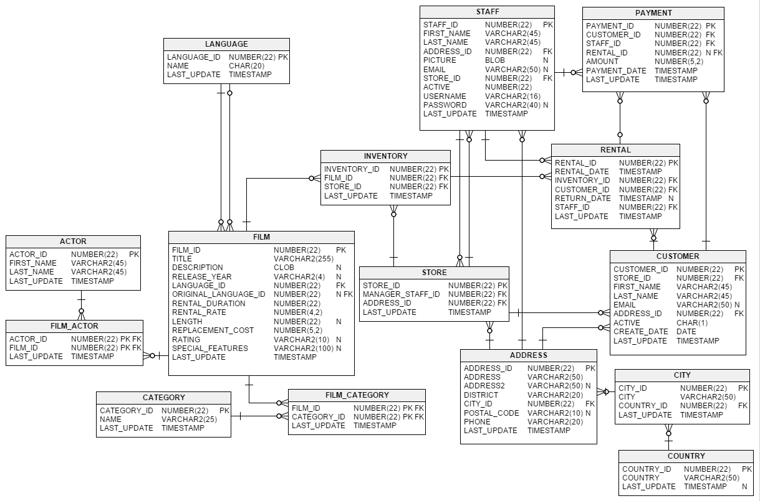

Slide 6
Data Exploration
These tables are interconnected, providing a comprehensive view of rental transactions, customer details, and film information.
Important relationships between tables include:
Customer and Rental: Connected by customer_id.
Rental and Inventory: Connected by inventory_id.Inventory and Film: Connected by film_id.
Film and Category: Connected by category_id through a junction table film_category.
Payment and Rental: Connected by rental_id.

Slide 7
Analytical Questions and Approach
Identifying the Most Frequently Rented Movies and Analyze Rental Patterns by Customer Demographics.
Customer Rental Behavior: Segment Customers Based on Their Rental History
Evaluate Revenue Over Time, Broken Down by Categories Such as Genre, Ratings, and Customer Segments
Inventory Management: Assess Availability and Turnover of DVDs
Inventory Management: Assess Availability and Turnover of DVDs

Slide 8
Approach
To identify the top rentals, a measure was created to count the rentals per film. Film was sorted by rental count and then visualized
The rental data was combined with the demographic category, city and country was used as the demographic.
total rentals was visualized by customer name to get the renter by customers. I also created a measure for customer segments. Turnover ratio was visualized over time.

Slide 9
Results
The Total rentals was 16000, the country count was 109, the number of customers was 599 and the cities where the rental happened was 600.
The top renter was Eleanor Hunt followed by Karl Seal with 46 rentals and Karl Seal with 45
The top renting city was Aurora

Slide 10
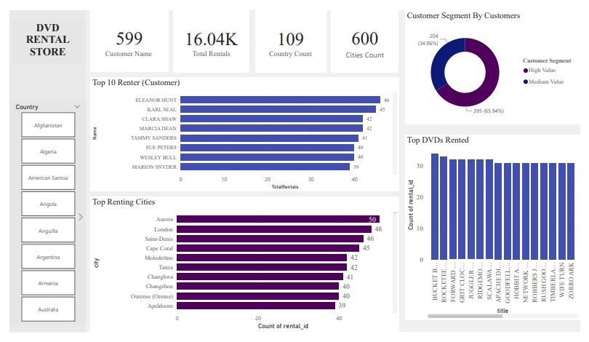

Slide 11
Defining the high value customers by their spending and rental frequency. A measure for monthy revenue was created MonthlyRevenue = SUMX(FILTER(‘sakila rental', ‘sakila rental'[rental_date]), ‘sakila payment'[amount])
A measure was also created to see the total inventory and created the dvd turnover measure by dividing rentals by inventory.

Slide 12
Results
The Total Revenue gotten from rentals is 67,410, The average rental price is 4.20.
The genre with the highest revenue is Sports with 5314.21 in revenue.
Revenue was generated more in the PG-13 rating
July of 2005 produced the most revenue.

Slide 13
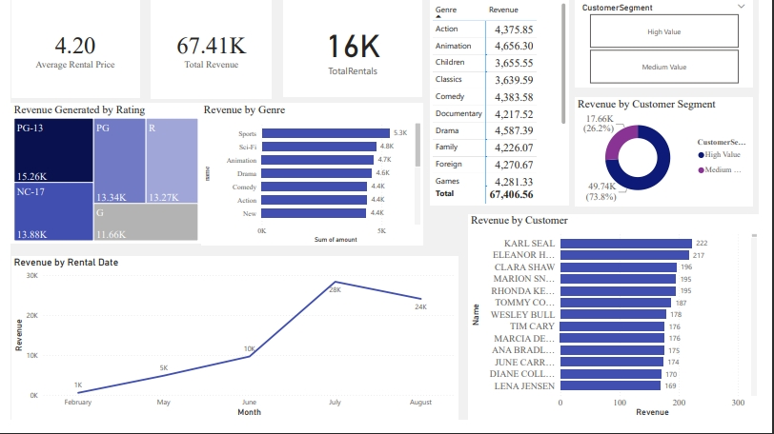

Slide 14
Approach
The total number of film is 958, with an average rental duration of 5.03. The Inventory count is 4581 and the film with the highest rental duration is Afircan egg with 7.03
A measure for the last rental date was created in other to know who churned in the 6 months.

Slide 15
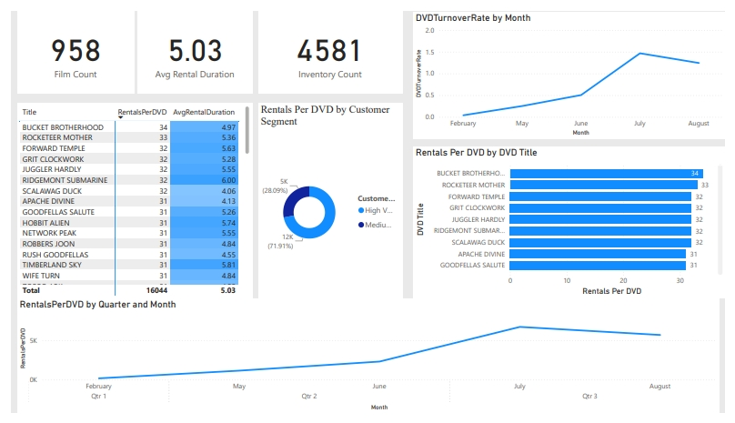

Slide 16
Recommendations
Inventory Optimization
High Turnover DVDs: Identify DVDs with high turnover rates and ensure sufficient copies are available.
Low Turnover DVDs: Identify DVDs with low turnover rates and consider reducing stock or replacing with more popular titles.
Rental Patterns: Analyze rental patterns to determine peak rental times and adjust inventory levels accordingly.
Additional Recommendations
Seasonal Trends: Adjust inventory based on seasonal trends observed from rental data.
Customer Preferences: Consider customer preferences and demographics to optimize the selection of DVDs.
Promotions: Implement promotions for low turnover DVDs to increase rental activity.

Slide 17
Conclusion
The analysis of the Sakila database in Power BI provided valuable insights into rental patterns, customer behavior, revenue trends, and inventory management. It also help check for patterns and helped me give recommendations to improve rentals and increase revenue

Slide 18
